Slide 1
The Curious Conundrum of Store 3
What lessons can we learn, and what future insights can we pursue, from the smallest store that could?

Slide 2
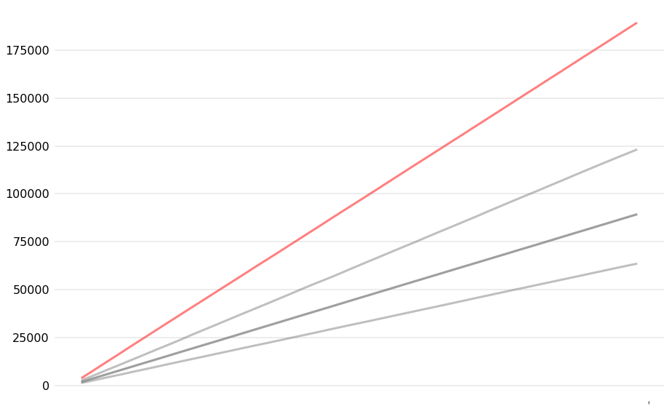
Store 3 is our highest earner. By far.
Cumulative Revenue, Excluding Holiday Season
Store 3
Store 2
$
Store 4
Store 5
Store 1
Week 1
Week 45

Slide 3
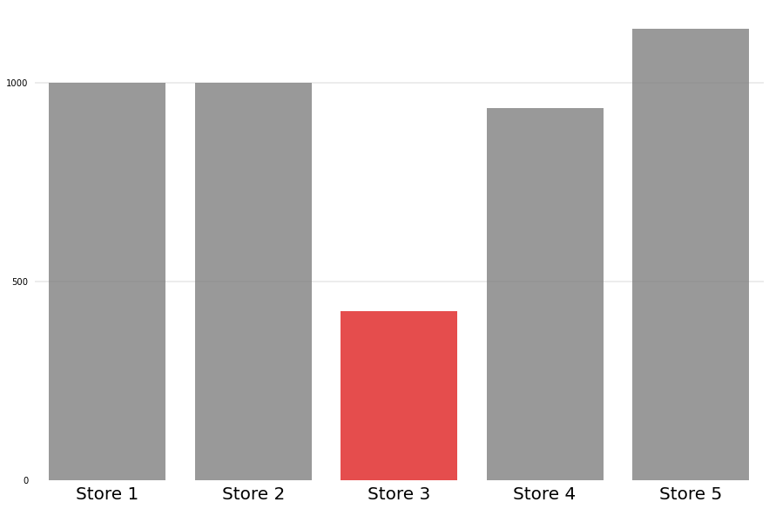
However, Store 3’s unique inventory count is the lowest of all the stores.
Count of Unique SKUs by Store
1000
500

Slide 4
Store 3’s items aren’t, on average, more expensive than the other stores’ items.
Mean item price by store
Store 3
Store 4
Store 1
Store 2
Store 5
$53
$54
$55
$56
Median item price by store
Store 1
Store 4
Store 2
Store 5
Store 3
$53
$54
$55
$56

Slide 5
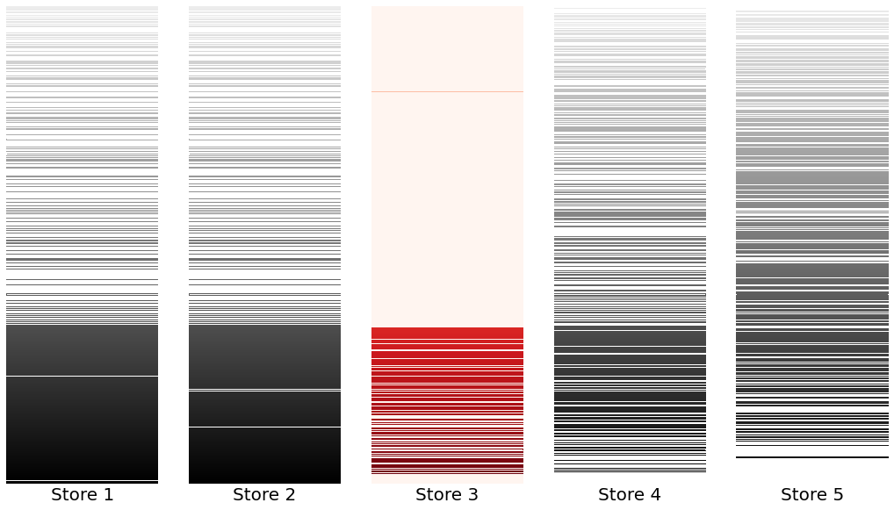
Item curation!
SKUs carried by each store, ranked by overall popularity
Least popular
Most popular

Slide 6
Store 3’s careful curation of its inventory has allowed it to maintain lower overhead while simultaneously killing it in sales and revenue.

Slide 7
Future Actions
Further analyze Store 3’s inventory and target customers
Enact findings to increase revenue in lagging stores

